Slide 1
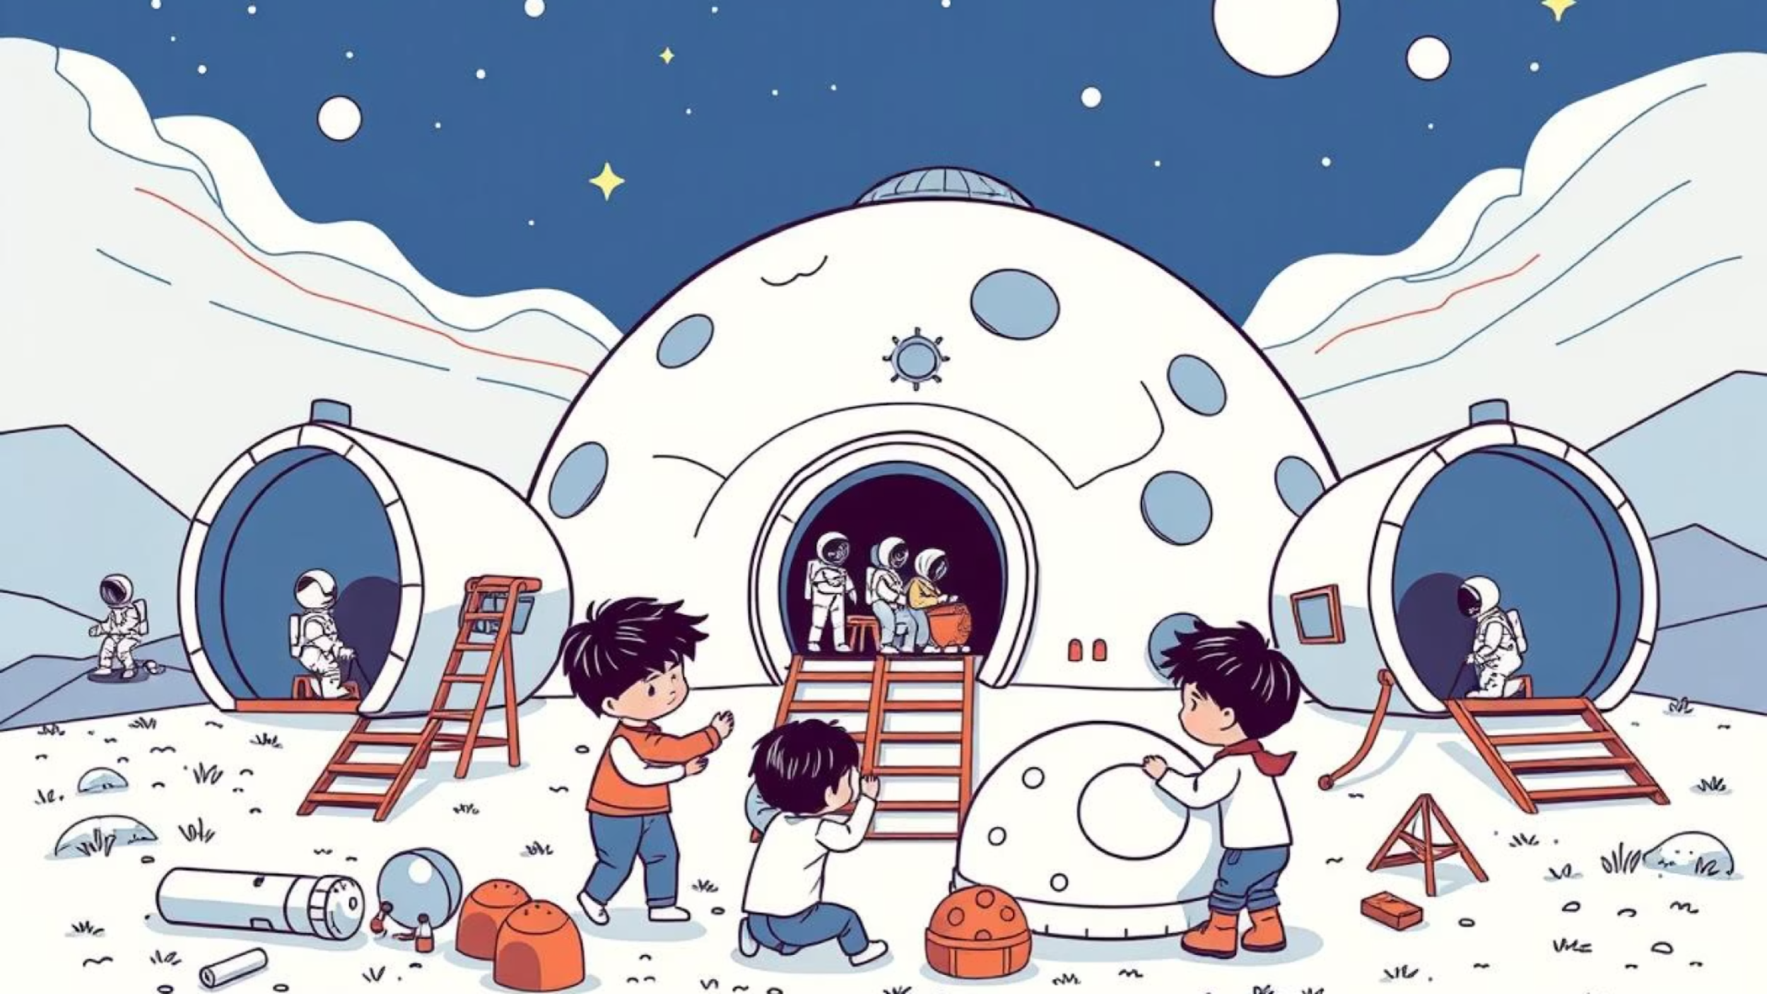
Lunar Base
Lesson 5: Coding Your Base
Notes:
https://edu.delightex.com/YZD-EFM

Slide 2
Lesson Objectives
Code at least one element to move on a path
Program buttons to control doors using "when clicked" events
Make objects behave differently in low-gravity environments
Key Skills: Event programming, physics simulation, cause and effect
Notes:
https://edu.delightex.com/YZD-EFM
Understand the components and structure of a completed space base.
Design and create your unique base using domes, tubes, and airlocks.
Add characters and animate their movements within your lunar base design.

Slide 3
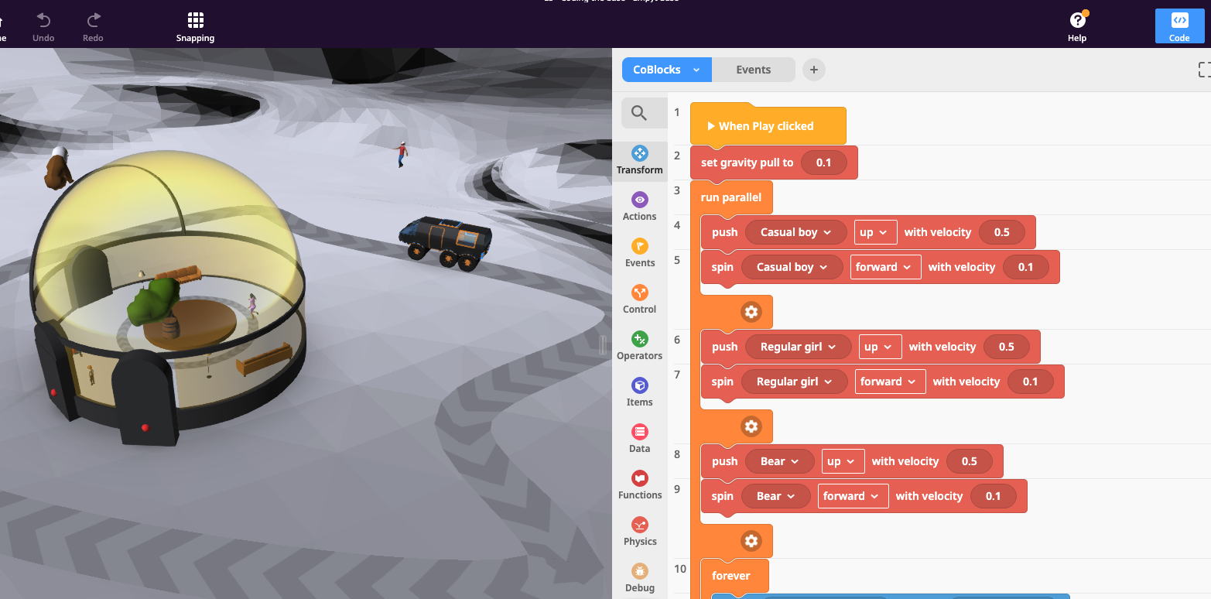
Watch this interactive base in action:
https://edu.delightex.com/YZD-EFM
Notes:
https://edu.delightex.com/YZD-EFM

Slide 4
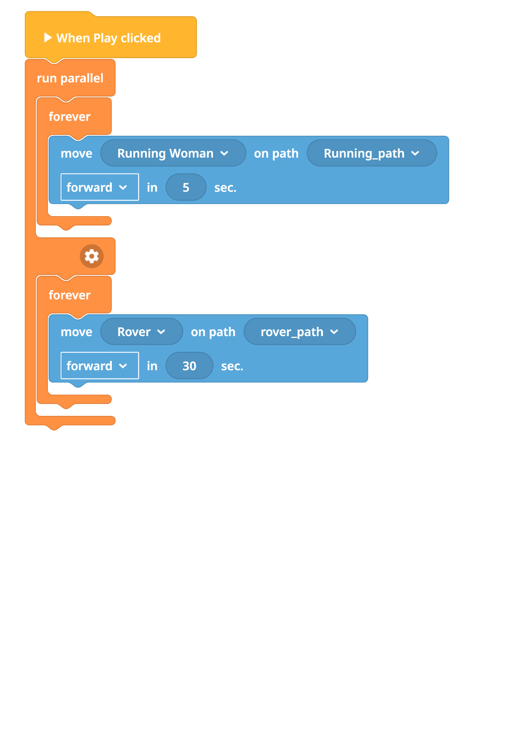
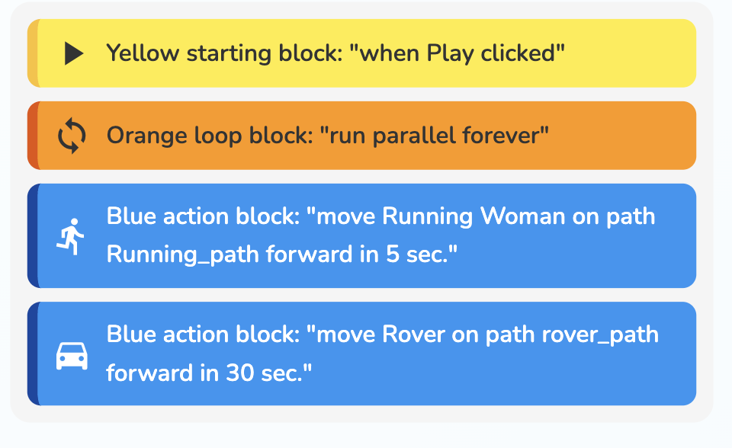
Using Paths Example

Slide 5
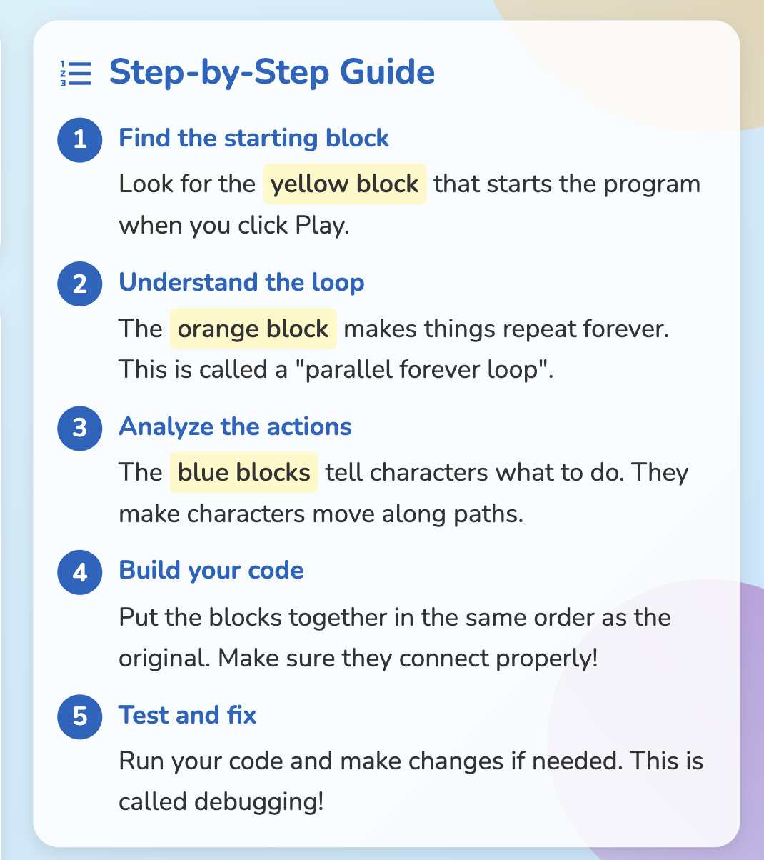
Using Paths Example

Slide 6
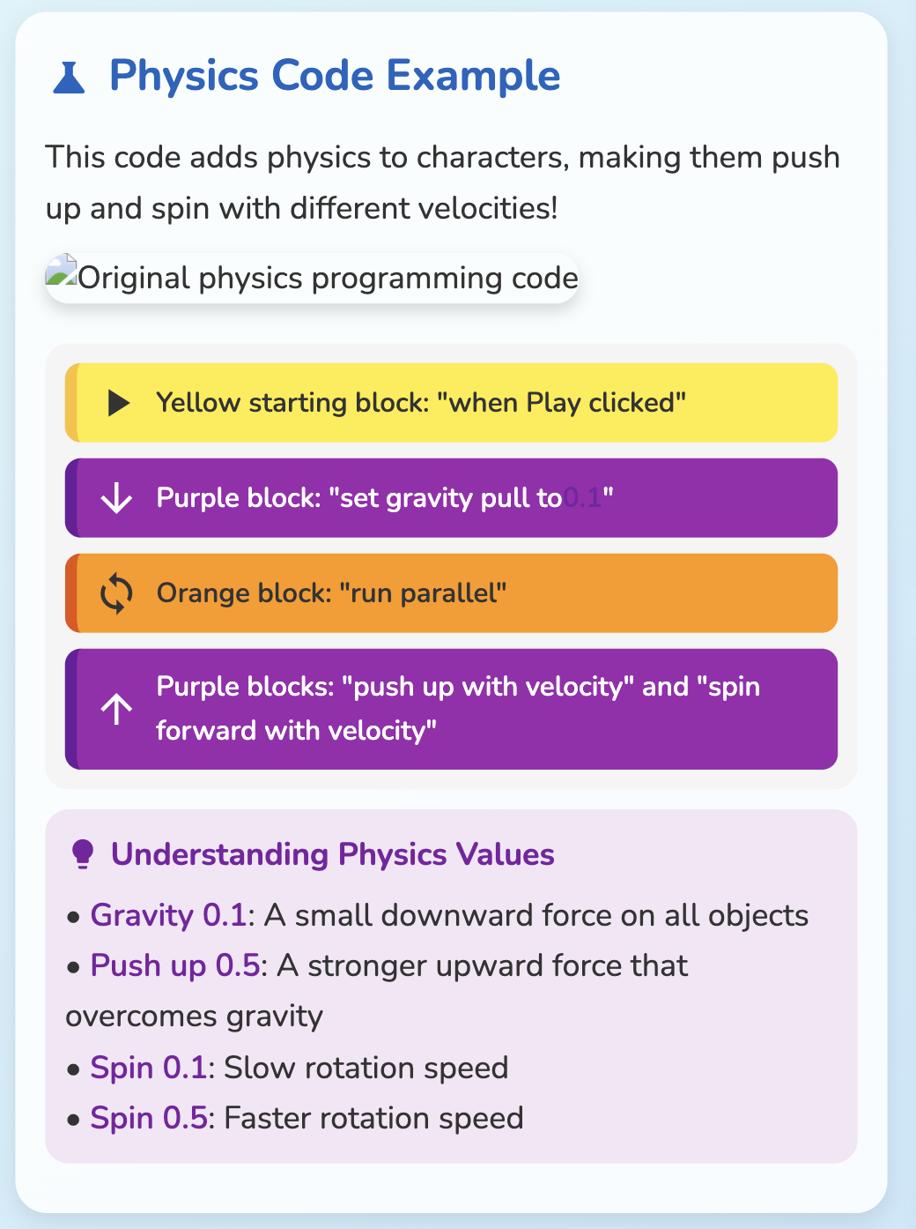
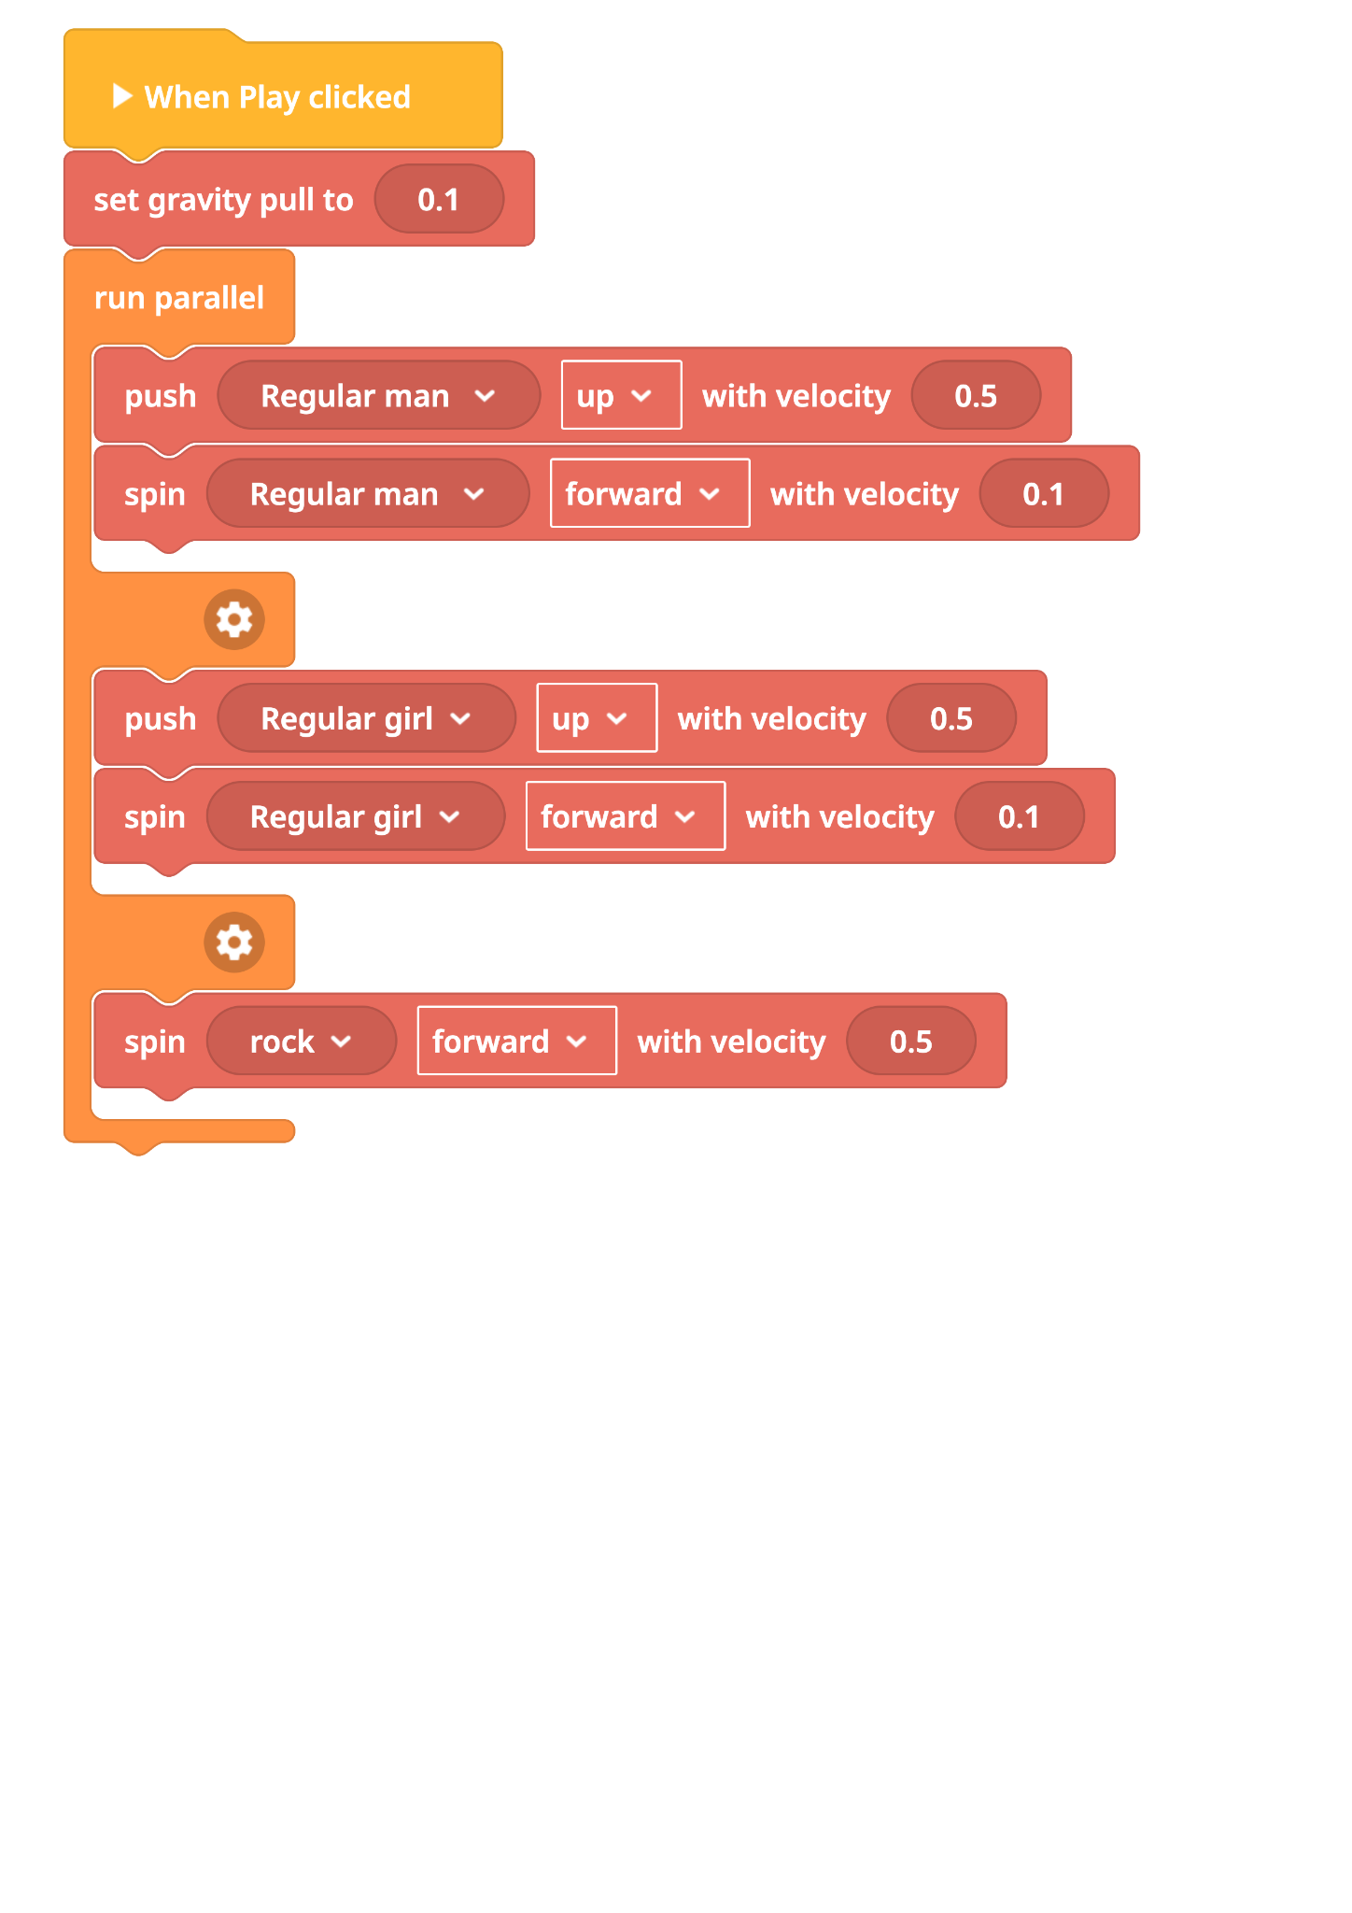

Slide 7
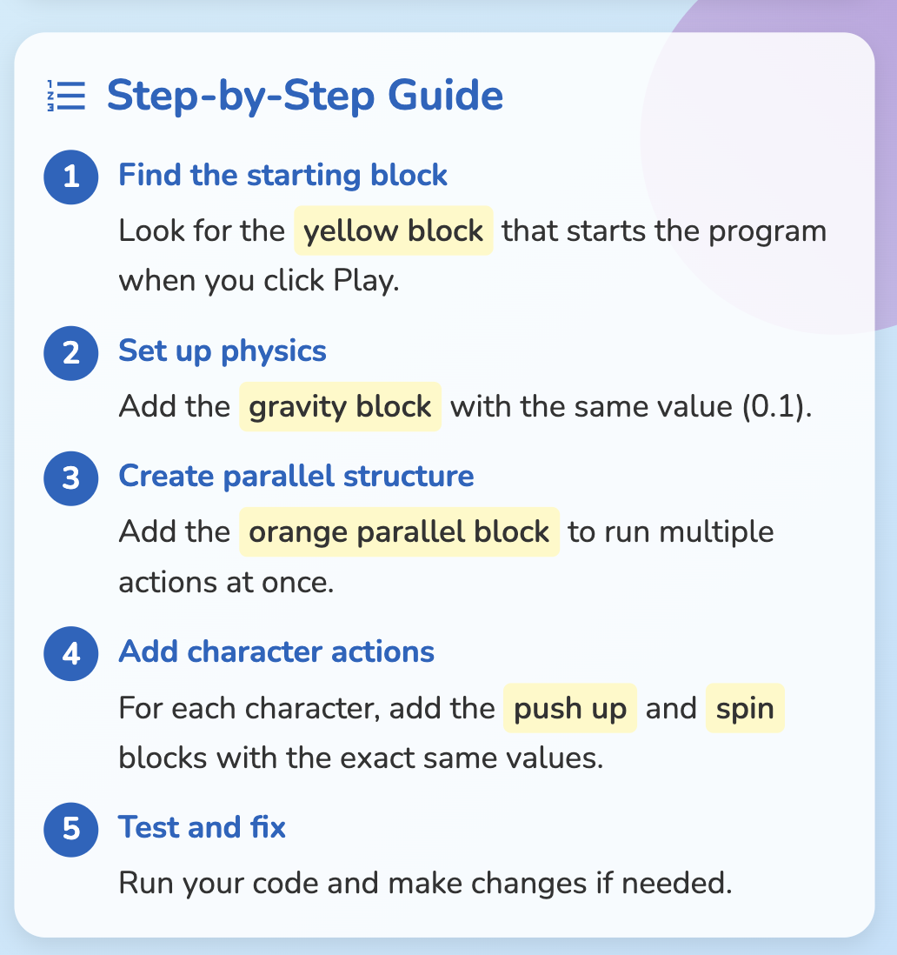

Slide 8
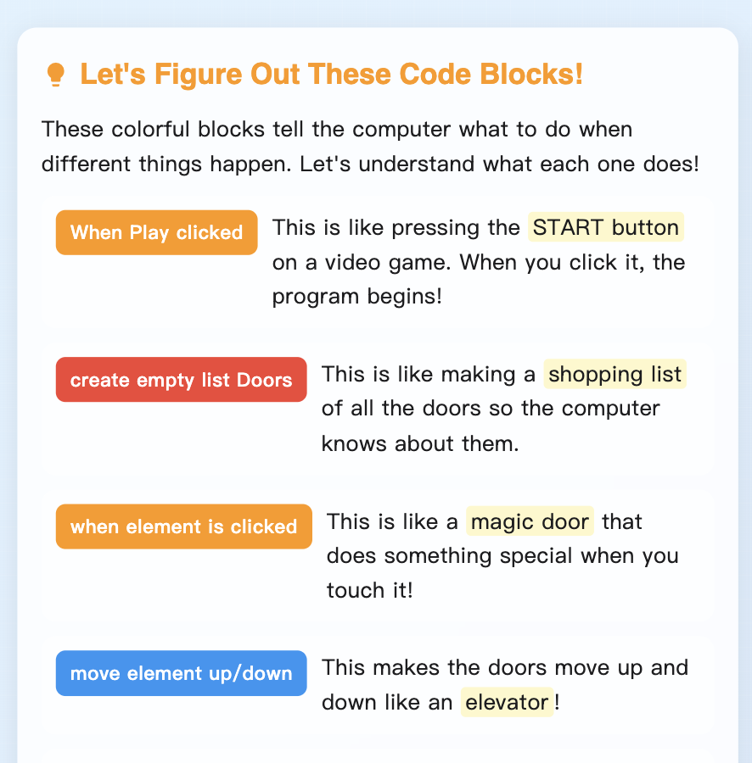
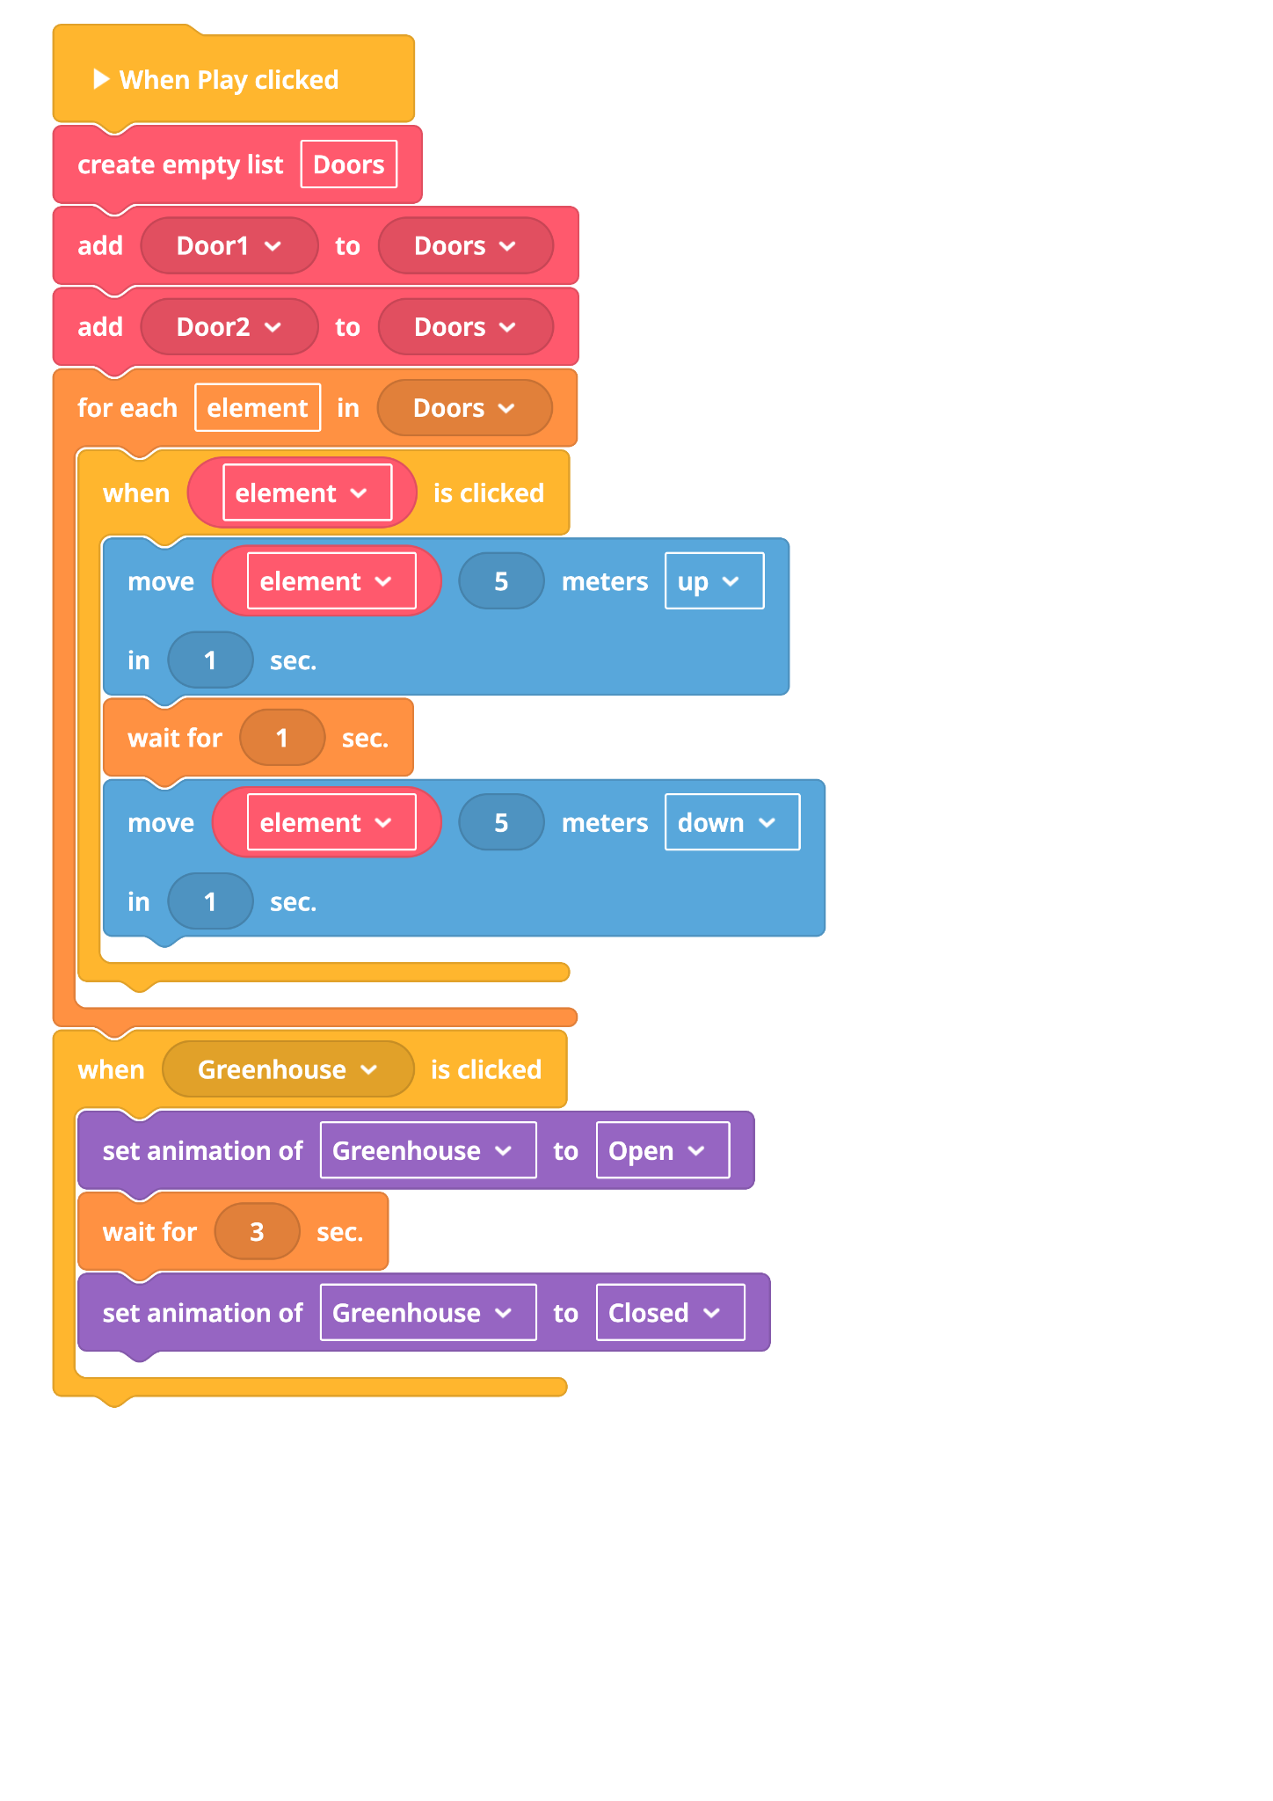
Creating multiple events in a list

Slide 9
Mini Plenary
Test Your Interactive Systems:
✓ Do your doors open and close when buttons are clicked?
✓ Can you make characters jump or move when clicked?
✓ Does the low gravity setting make objects behave differently?
✓ Are your interactive systems responding consistently?
✓ Do your doors close automatically after opening?
If your systems are working, you're ready for the challenge levels!
If you answered YES to most, great job! You're ready for more fun!

Slide 10
Mild Challenge: Your First Steps on the Moon
Mission: Build a safe and functional home for one astronaut.
What You Need:
1 main habitat dome
1 airlock door
1 character + animation
Success Looks Like: A secure living area with a clear entrance.
Hot Challenge: Expanding Your Lunar Outpost
Mission: Create a base with different areas for living and working.
What You Need:
2 domes (e.g., living & lab)
Tube connectors
2 airlock doors
2-3 characters placed around
Success Looks Like: Connected areas, multiple entry points, and characters doing different tasks.
Spicy Challenge
Mission: Design a large, advanced lunar city with many specialized areas.
What you need to build:
At least three domes, each with a different color and function.
A detailed network of tubes connecting the domes.
Many airlocks placed in smart locations.
Multiple characters with unique jobs.
Bonus: Characters that follow custom patrol routes.
Goal: Create an advanced, interactive, and professional-looking lunar city.

Slide 11
WHAT WE'VE ACHIEVED TODAY:
🤖 Programmed interactive systems that respond to user input
⚖️ Simulated realistic space physics and gravity
🚪 Created working airlock systems like real space stations
KEY LEARNING: Your bases now work like real space systems! You've learned how cause-and-effect programming makes technology respond to human actions.
You're thinking like real space engineers!

